Slide 1
TBC-301 Data Communication and Computer Network
Network Introduction

Slide 2
Introduction
“Two computers are said to be interconnected if they interchange information. The connection between the separate computers can be done via a copper wire, fiber optics, microwaves or communication satellite.”
A system with one control unit and many slaves, or a large computer with remote printers and terminals is not called network, it is called a distributed system.

Slide 3
The aim of the computer network is the sharing of resources among various devices.
The purpose of having computer network is to send and receive data stored in other devices over the network. These devices are often referred as nodes.

Slide 4
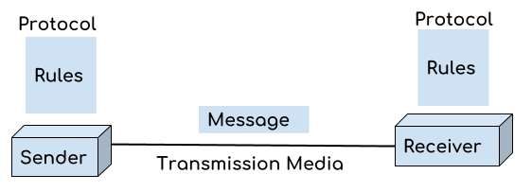
There are basic components of a computer network
Message: It is the data or information which needs to be transferred from one device to another device over a computer network.
Sender: Sender is the device that has the data and needs to send the data to other device connected to the network.

Slide 5
Receiver: A receiver is the device which is expecting the data from other device on the network. Transmission media: In order to transfer data from one device to another device we need a transmission media such as wires, cables, radio waves etc.
Protocol: A protocol is a set of rules that are agreed by both sender and receiver, without a protocol two devices can be connected to each other but they cannot communicate. In order to establish a reliable communication or data sharing between two different devices we need set of rules that are called protocol. For example, http and https are the two protocols used by web browsers to get and post the data to internet, similarly SMTP protocol is used by email services connected to the internet.

Slide 6
Uses Of Computer Network
Resource sharing: Resource sharing is the sharing of resources such as programs, printers, and data among the users on the network without the requirement of the physical location of the resource and user.
Server-Client model: Computer networking is used in the server-client model. A server is a central computer used to store the information and maintained by the system administrator. Clients are the machines used to access the information stored in the server remotely.
Communication medium: Computer network behaves as a communication medium among the users. For example, a company contains more than one computer has an email system which the employees use for daily communication.
E-commerce: Computer network is also important in businesses. We can do the business over the internet. For example, amazon.com is doing their business over the internet, i.e., they are doing their business over the internet.

Slide 7
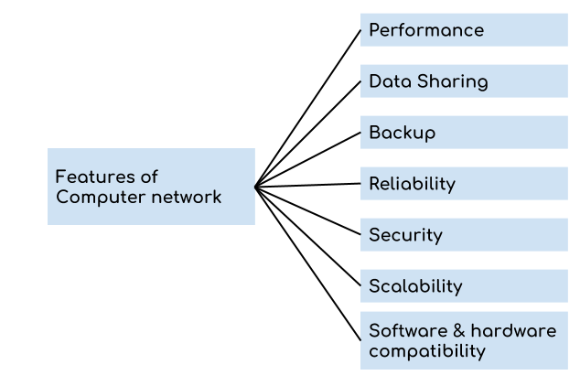
Features

Slide 8
A computer network has following features:
Performance: Performance of a computer network is measured in terms of response time. The response time of sending and receiving data from one node (computer in a computer network are often referred as node) to another should be minimal.
Data Sharing: One of the reason why we use a computer network is to share the data between different systems connected with each other through a transmission media.

Slide 9
Backup: A computer network must have a central server that keeps the backup of all the data that is to be shared over a network so that in case of a failure it should be able to recover the data faster.
Software and hardware compatibility: A computer network must not limit all the computers in a computer network to use same software and hardware, instead it should allow the better compatibility between the different software and hardware configuration.
Reliability: There should not be any failure in the network or if it occurs the recovery from a failure should be fast.
Security: A computer network should be secure so that the data transmitting over a network should be safe from unauthorised access. Also, the sent data should be received as it is at the receiving node, which means there should not be any loss of data during transmission.
Scalability: A computer network should be scalable which means it should always allow to add new computers (or nodes) to the already existing computer network. For example, a company runs 100 computers over a computer network for their 100 employees, lets say they hire another 100 employees and want to add new 100 computers to the already existing LAN then in that case the local area computer network should allow this.

Slide 10
Computer Network Architecture
A Computer Architecture is a design in which all computers in a computer network are organized. A architecture defines how the computers should get connected to get the maximum advantages of a computer network such as better response time, security, scalability etc. The two most popular computer architectures are P2P (Peer to Peer) and Client-Server architecture.

Slide 11
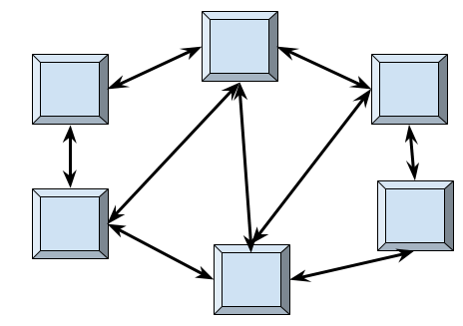
Peer to Peer Architecture

Slide 12
In peer to peer architecture all the computers in a computer network are connected with every computer in the network. Every computer in the network use the same resources as other computers. There is no central computer that acts as a server rather all computers acts as a server for the data that is stored in them.
Advantages of a Peer to Peer Architecture
Less costly as there is no central server that has to take the backup.
In case of a computer failure all other computers in the network are not affected and they will continue to work as same as before the failure.
Installation of peer to peer architecture is quite easy as each computer manages itself.
Disadvantages of a Peer to Peer Architecture
Each computer has to take the backup rather than a central computer and the security measures are to be taken by all the computers separately.
Scalability is a issue in a peer to Peer Architecture as connecting each computer to every computer is a headache on a very large network.

Slide 13
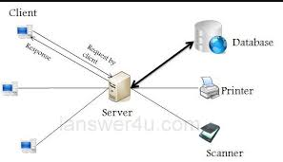
Client Server Architecture

Slide 14
In Client Server architecture a central computer acts as a hub and serves all the requests from client computers. All the shared data is stored in the server computer which is shared with the client computer when a request is made by the client computer.
All the communication takes place through the server computer, for example if a client computer wants to share the data with other client computer then it has to send the data to server first and then the server will send the data to other client.

Slide 15
Advantages of Client Server Architecture
1. Data backup is easy and cost effective as there is no need to manage the backup on each computer. 2. Performance is better as the response time is greatly improves because the server is more powerful computer than the other computers in the network. 3. Security is better as unauthorized access are denied by server computer and all the data goes through the server. 4. Scalability is not an issue in this Architecture as large number of computers can be connected with server.
Disadvantages of Client Server Architecture
1. In case of server failure entire network is down. 2. Server maintenance cost is high as the server is the main component in this Architecture 3. Cost is high as the server needs more resources to handle that many client requests and to be able to hold large amount of data.

Slide 16
Goals and Applications of networks:-
Network goals:- The main goals of network as follows.
Resource sharing:- This is the main aim of a computer network. It means to make all programs peripherals and data available to any one computer on the network to all other computers in the network without regard to the physical locations of them. Thus user at large distances can share the resources or can see data of a computer in the same way that a local user uses them. Another aspect of resource sharing is load sharing. That is if required, a job can be performed using various computers in network by portioning it which reduces time consumption and load both for a particular computer.
High reliability:- A second goal is to provide high reliability by having alternative sources of supply. For example, all files could be replicated on two or three machines, so if one of them is Unavailable, the other copies could be available.

Slide 17
Cost Reduction:- Another goal of networking is reduction of cost. Resource sharing automatically reduces cost and hence money can be saved.
Improve Performance:- Another closely related goal is to increase the systems performance. The performance of a computer can be improved by adding one or more processors to it as the work load on it grows. For example if the system is full instead of replacing it buy a larger one at large expansive it is better to add more processors to it on less cost and less disruption to the user.
Communication Medium:- Computer networks provide a powerful communication medium. A file that was updated/modified on a network can be seen by the other users on the network immediately.

Slide 18
Network application:- Some of the network applications in different fields are the following.
1. Marketing and sales
2. Financial services
3. Manufacturing. CAD, CAM etc.
4. Information services
5. Cellular telephone
6. Cable television
7. Teleconferencing
8. EDI
9. E-mail etc.

